Slide 1

Modern AI: Data, Machine Learning, and Generative AI
Presenters: Louvere Walker-Hannon (Lwalker@mathworks.com)
Dr. Laura Keen (Lkeen@mathworks.com)
Account Mngr.: Paul Nihill (pnihill@mathworks.com)

Slide 2
A Practical Introduction

Slide 3
What is Artificial Intelligence in 2025?

Slide 4
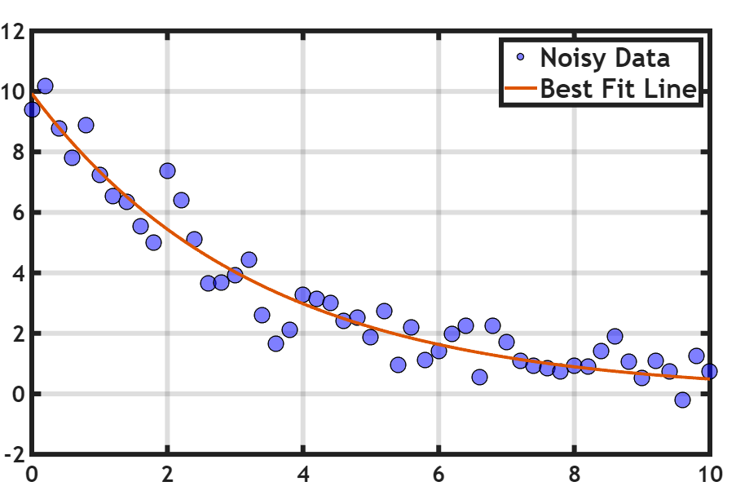

Slide 5

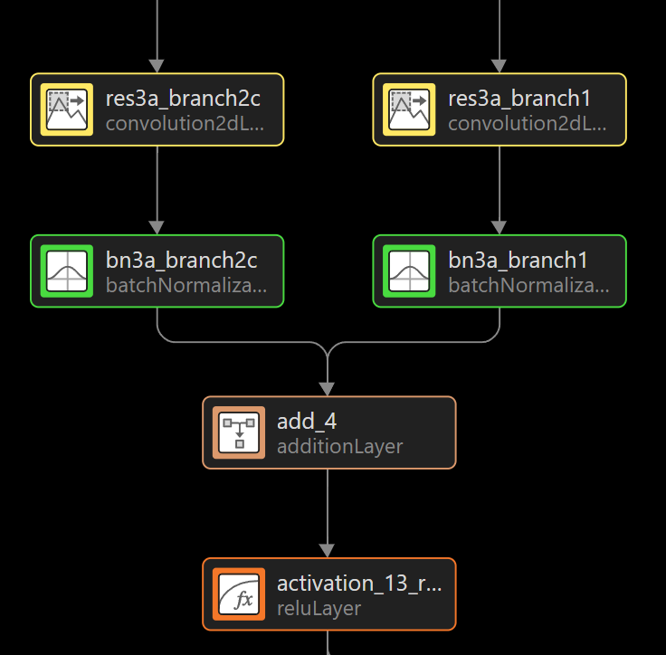
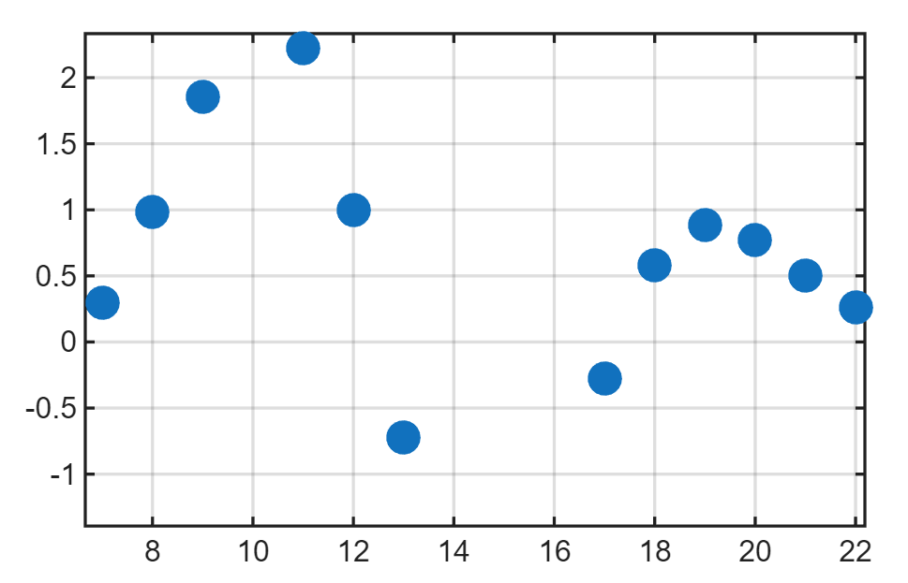



Slide 6
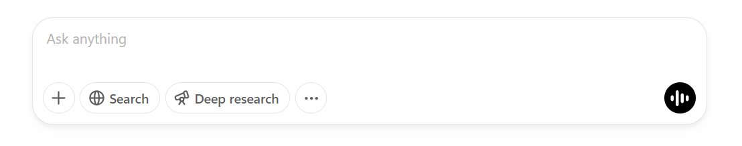

Slide 7


Slide 8

Agenda
ARTIFICIAL INTELLIGENCE
WITH MATLAB
OPEN SOURCE INTEGRATION, SOURCE CONTROL
MATLAB MOBILE, MORE EXAMPLES

Slide 9






Seminar Map
MATLAB Live Script Notebooks
Data Preprocessing & Analysis
Deploy Pretrained Model
Examples
Resources
Sync w/Git
Train Machine Learning Model

Slide 10
Agenda
ARTIFICIAL INTELLIGENCE
WITH MATLAB
OPEN SOURCE INTEGRATION, SOURCE CONTROL
MATLAB MOBILE, MORE EXAMPLES

Slide 11












AI is more than just a model…
Data Preparation
AI Modeling
Simulation & Test
Deployment
AI Modeling
Data pre-processing
Model design and tuning
Integration with complex systems
Embedded devices
Model design and tuning
Model design and tuning
Feature engineering
Hardware accelerated training
Explain models and predictions
System simulation with AI models
Enterprise systems
Python interoperability
Interoperability
Edge, cloud, desktop
Python interoperability
Simulation-generated data
Explain models and predictions
System verification and validation

Slide 12
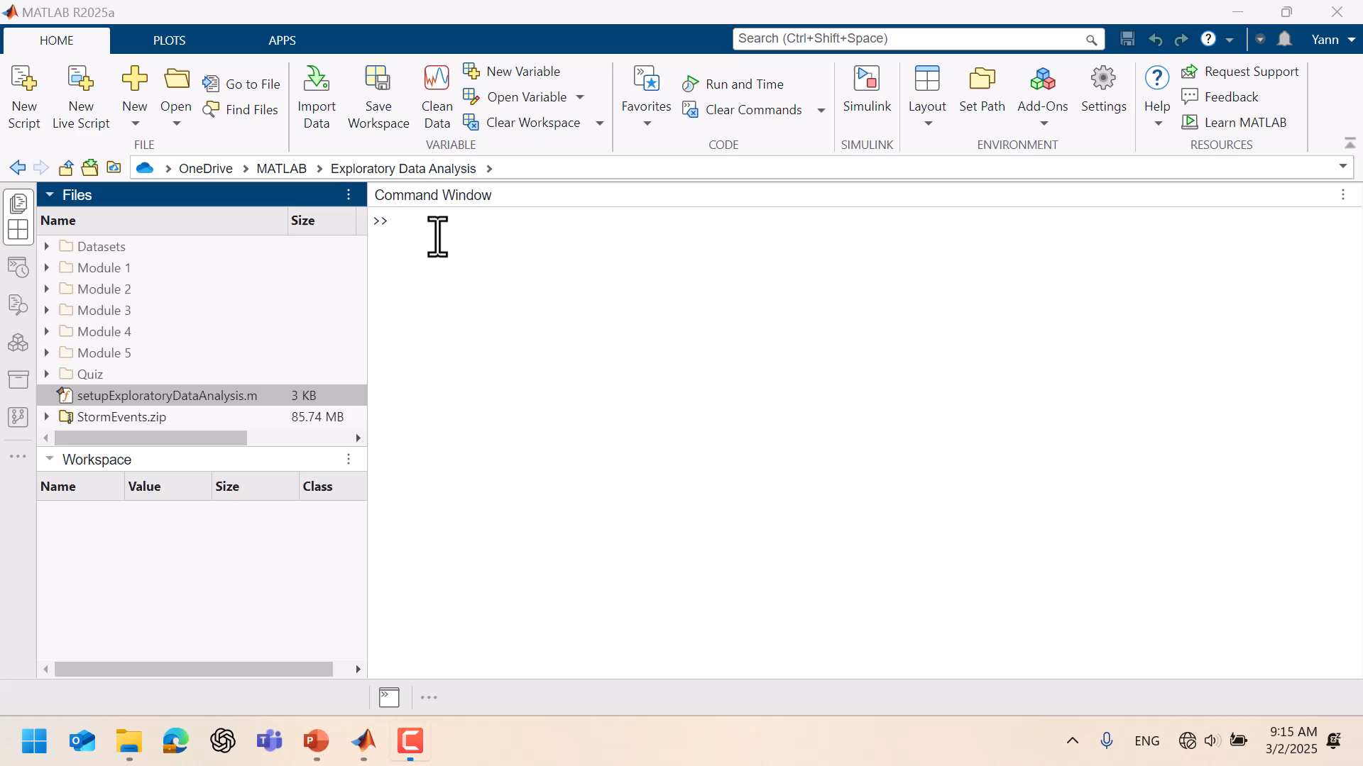

Slide 13
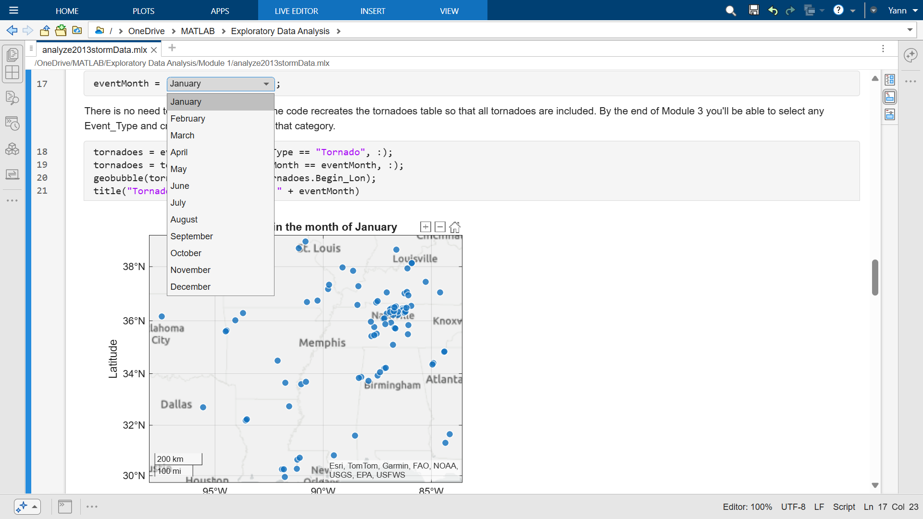

Slide 14
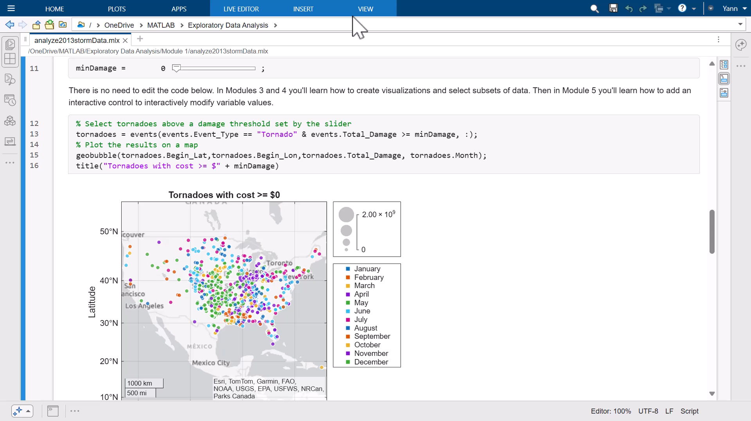

Slide 15
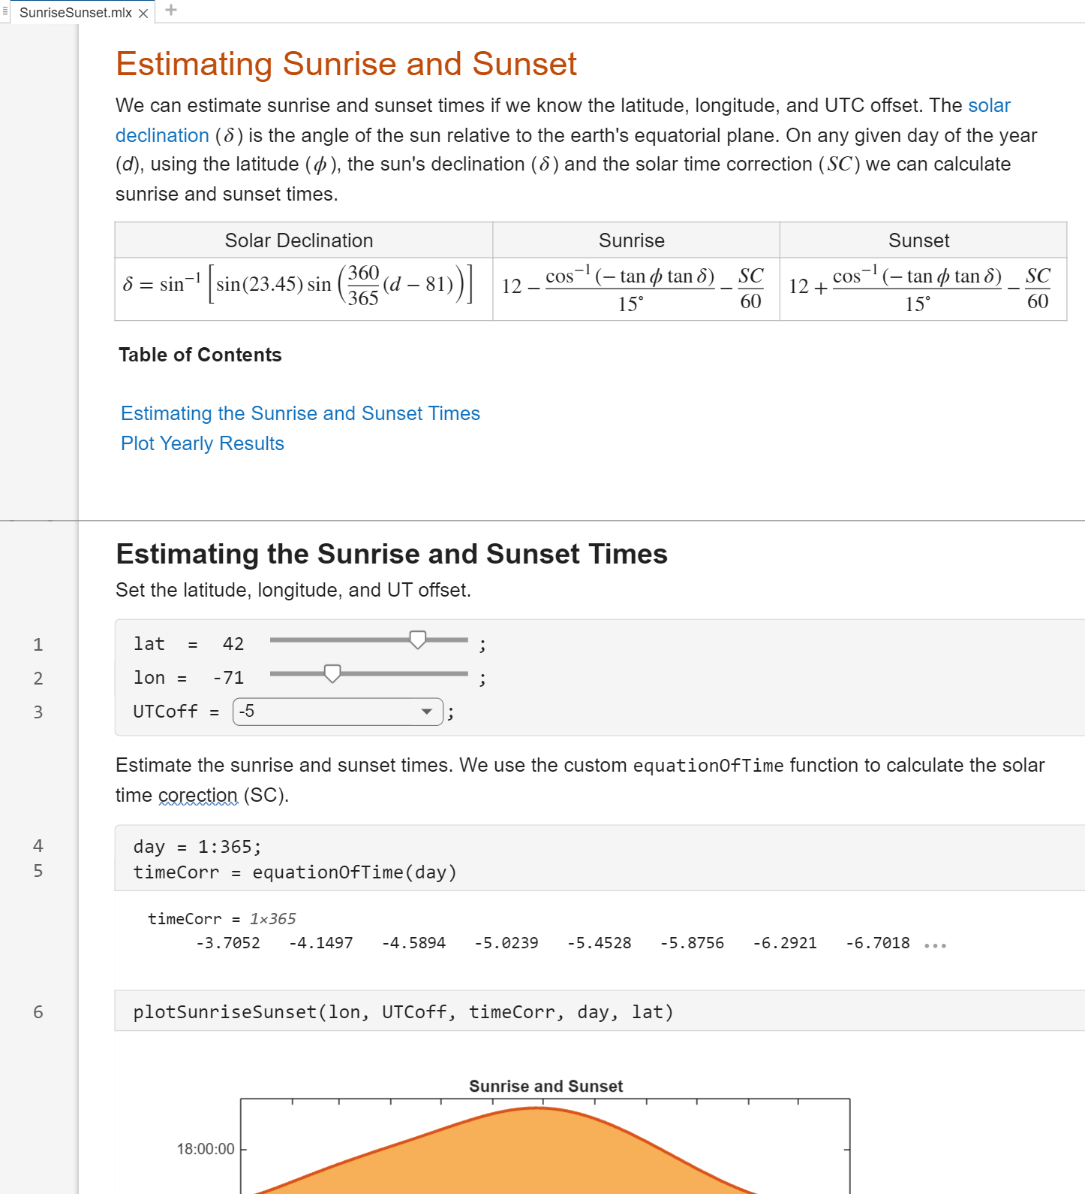
Create interactive, human readable scripts in the Live Editor
Make scripts readable
Richly formatted text
Interleave code & output
Add interactivity
Hyperlinks and table of contents
Live Controls to adjust parameters
Share with non-MATLAB users
Export as report (pdf, docx, etc.)
Share through GitHub and MATLAB Online
Notes:
The Live Editor provides an environment for interactive, human readable scripts.
<click> It provides richly formatted text such as tables and equations, and it interleaves code and output to create an executable document.
<click> You can add interactivity in form of hyperlinks and table of contents, as well as controls such as sliders and drop downs to make modifying the script easier and more intuitive.
<click> You can share these Live Scripts as static reports, or through GitHub and MATLAB Online as we discussed on an earlier slide.

Slide 16
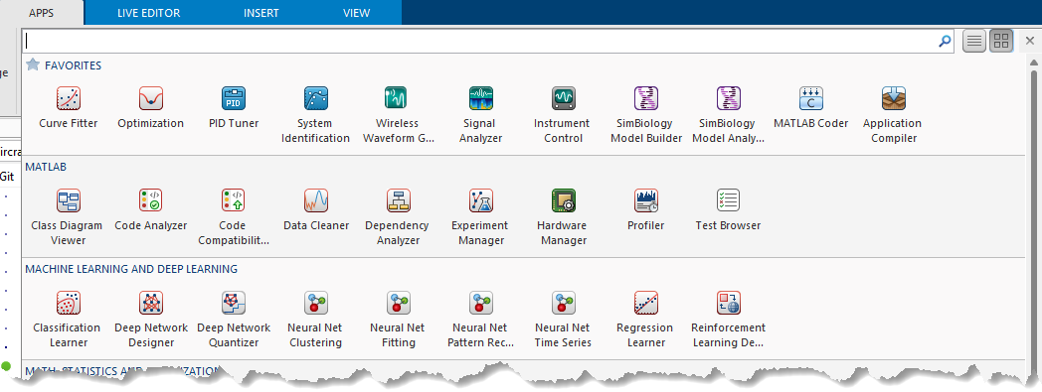
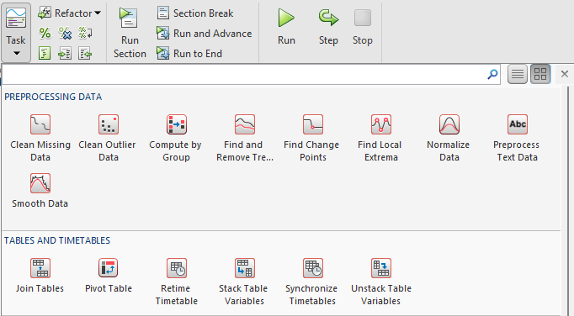
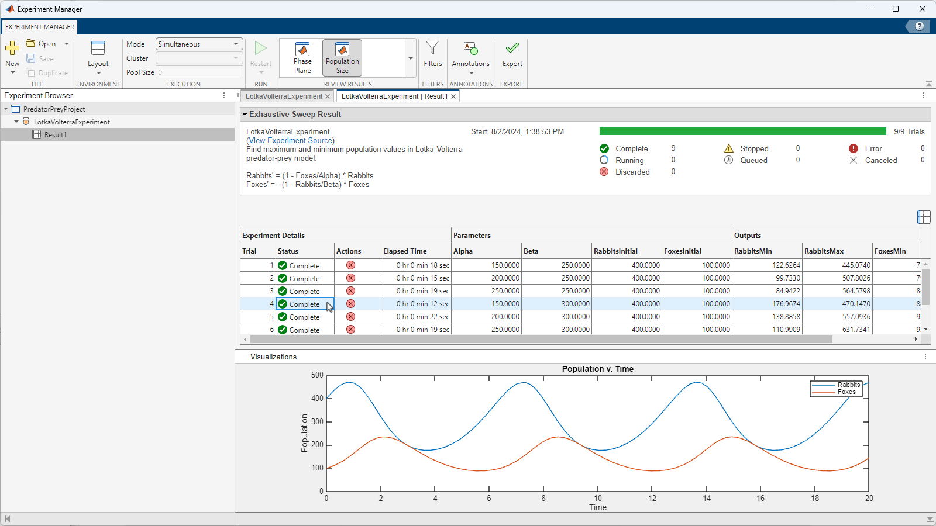
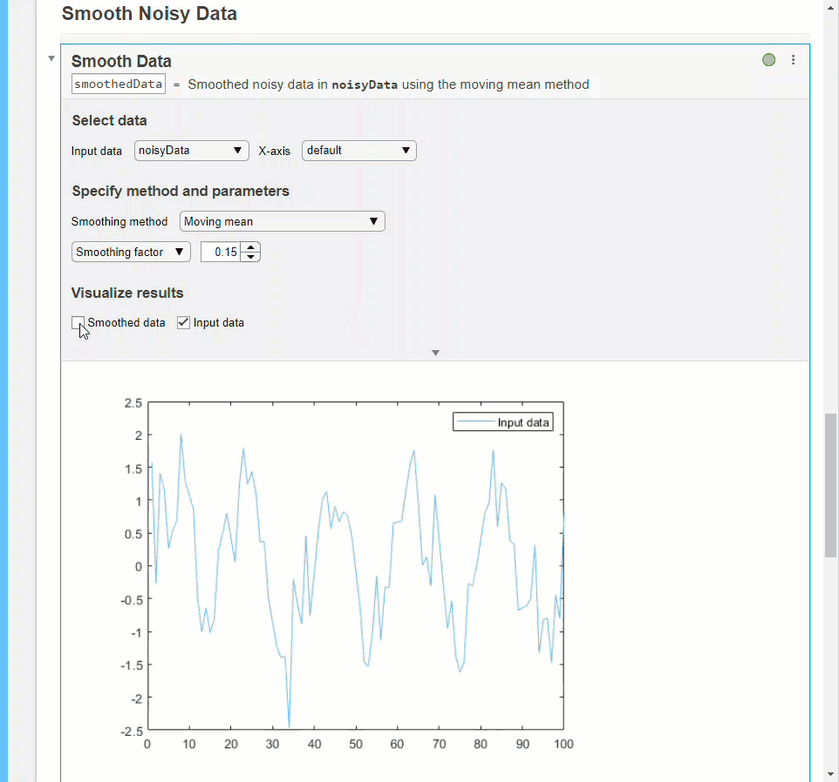
Interactively solve tasks and workflows
Live Tasks solve steps within the Live Editor
Apps solve larger, multi-step workflows
Generate the code for your solution
40+ Live Tasks and 120+ Apps
Build and share custom Tasks and Apps
Notes:
MATLAB provides many tools to interactively and iterative solve both smaller tasks and larger workflows. Live Tasks embed directly in your live script and provide an easy way iteratively solve a narrow problem, such as this example were we can try out different smoothing algorithms to see what works best with our data.
<click> Apps focus on larger workflows, like cleaning data, managing experiments, training machine learning models, and tuning controls systems.
<click> Both tasks and apps generate the MATLAB code to replicate your work whenever that makes sense. We have dozens of these tools across data analysis, engineering, and AI. You can also build and share your own custom tasks and apps.

Slide 17
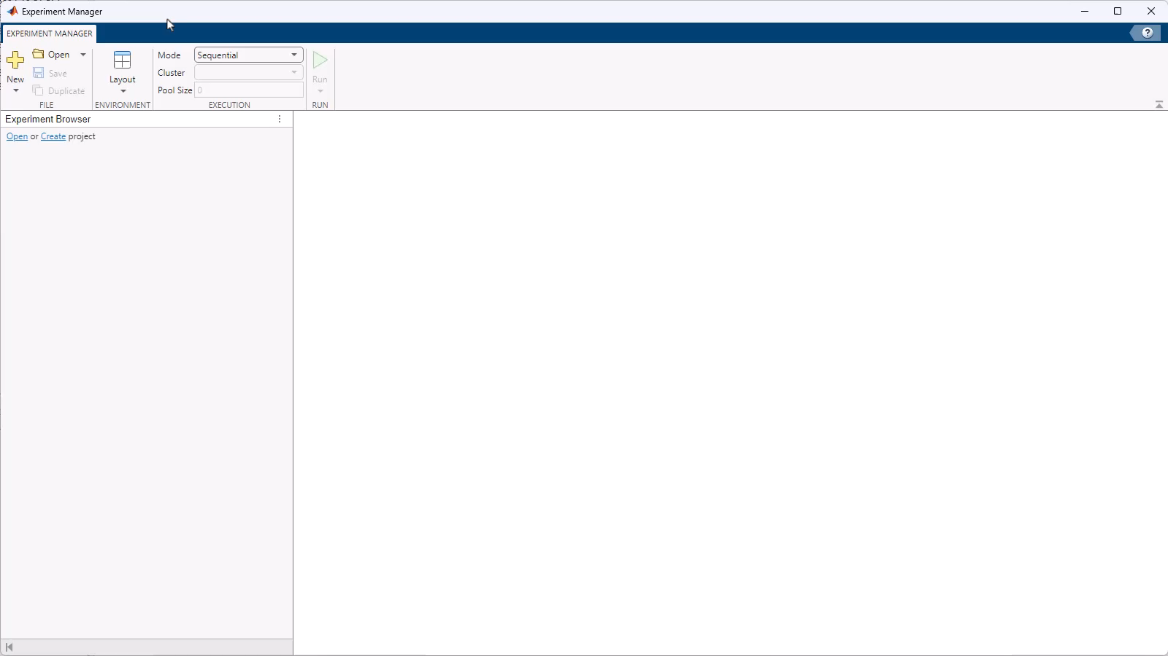
Use Experiment Manager App to perform computational experiments
Create and manage experiments
Parameter sweeps and hyperparameter tuning
Parallel and batch processing
Pre-built experiments for machine learning and AI
Notes:
One example is the Experiment Manager app, which provides tools for setting up and managing computational experiments. The app provides templates for common use cases like parameter sweeps and hyperparameter tuning of machine learning models. We can define the parameters to experiment with, and leverage additional hardware with parallel and batch execution. As we run our experiments, MATLAB keeps track of the results and provides tools for exploring them. This is just one example of over 120 such apps across the platform.

Slide 18
Agenda
ARTIFICIAL INTELLIGENCE
WITH MATLAB
OPEN SOURCE INTEGRATION, SOURCE CONTROL
MATLAB MOBILE, MORE EXAMPLES

Slide 19


MATLAB with Python demo

Slide 20
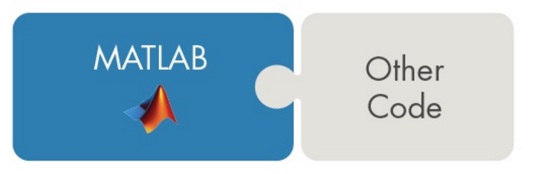
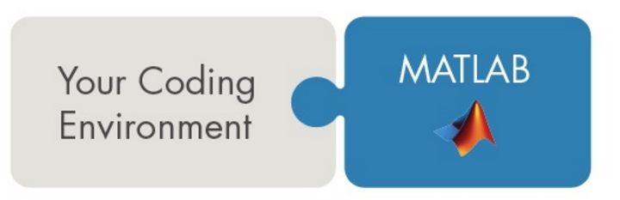
Collaborate and integrate using bidirectional interfaces
Co-execute MATLAB with other languages and applications
Bidirectional interfaces for:
Python
Java
C/C++
.NET
REST
COM
Fortran
Call code and libraries written in another language from MATLAB
Call MATLAB code from another language
Notes:
MATLAB has seven bidirectional interfaces for integrating with other code and applications. You can be in MATLAB and call code and libraries written in another language. Or you can work primarily in another language or environment and call out to MATLAB. You can do this through Python, Java, C and C++, .NET, REST, COM, and Fortran. Some of these interfaces have been around for decades, and the most recent one is the REST interface which was completed in 24a.

Slide 21
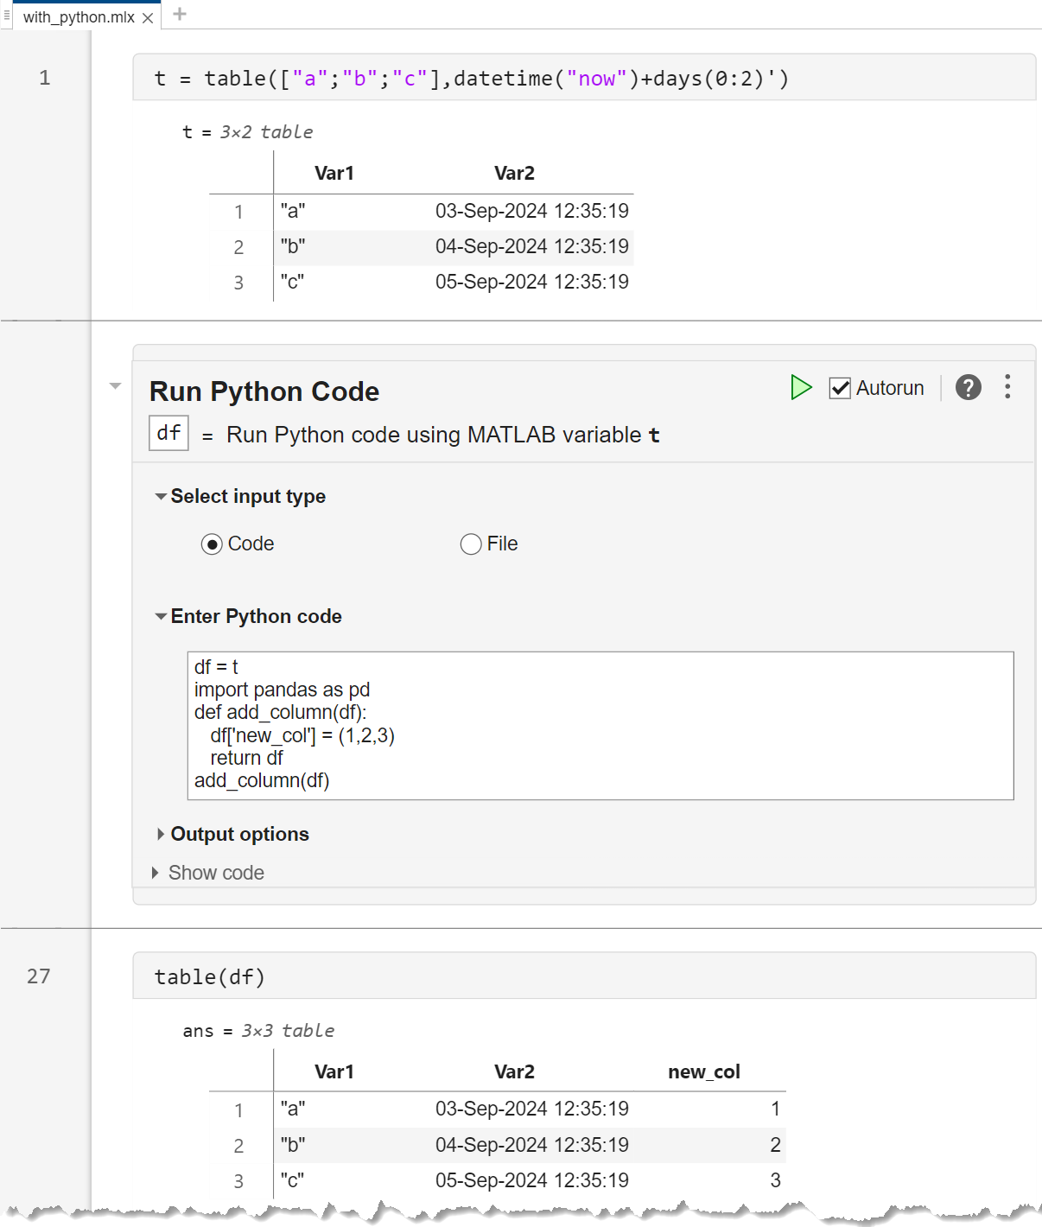
Calling python from MATLAB
Run Python commands/scripts from MATLAB
py.* - Execute a Python command inline: py.max(3,4)
pyrun - Execute Python statements defined as strings
pyrunfile - Execute a Python script file
Run Python Code Live Task - Automatically generate MATLAB code to call Python
Interchange Python datatypes within MATLAB
Numeric, string, list, tuple, datetime, timedelta, dictionaries, Pandas dataframe, …
Control MATLAB from Python
See MATLAB Engine for Python documentation
Notes:
Let’s look at just one example: calling Python from MATLAB. The simplest is the py dot syntax. Another option is pyrun, which will accept python statements that are defined as strings in MATLAB. And pyrunfile will run a python script file. The Run Python Code live task will automatically generate that interface code for you.
In this example we start with a table in MATLAB with some strings and datetimes. We send this to Pandas, manipulate as a Pandas dataframe, and then bring the result back as a MATLAB table.
You can interchange basically all the standard Python datatypes as well as Pandas dataframes. You can also go the other direction and from Python call into and control MATLAB using what’s call the MATLAB Engine interface. See the documentation for more details on that.

Slide 22
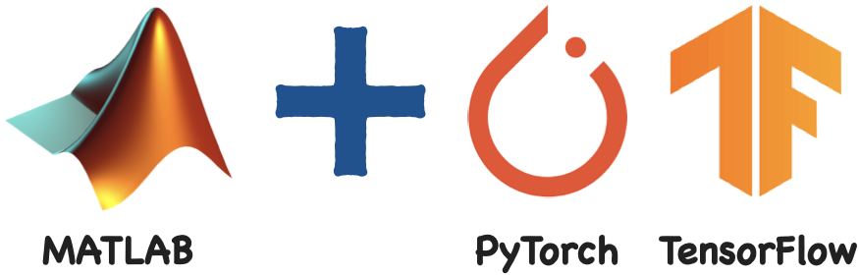
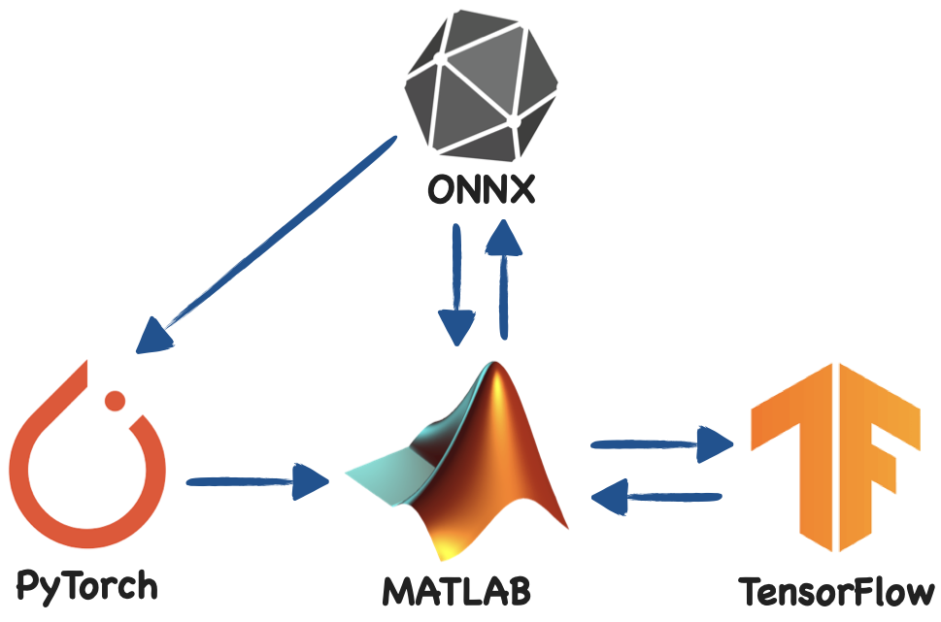
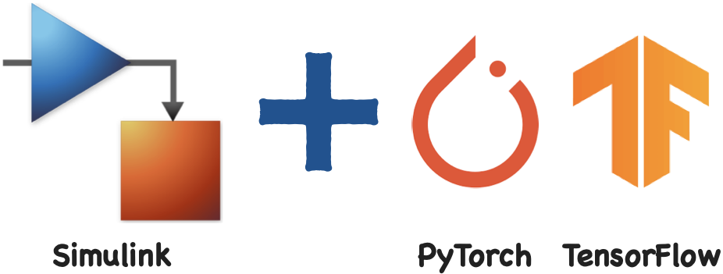
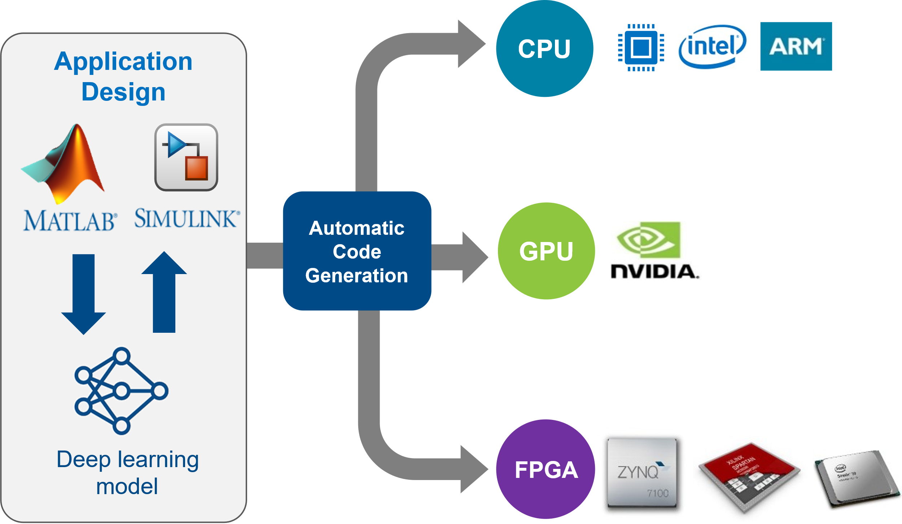
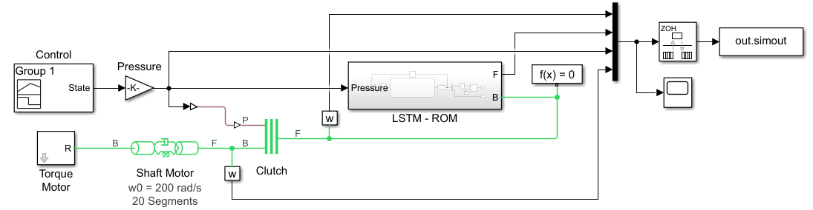
Combine MATLAB with Python for AI
Co-execute
Exchange Models
Techniques:
Engineering + AI
Deploy to Embedded Processors
Applications:
Notes:
A common use case is combining MATLAB with python for AI applications. There are two main techniques. The first is co-execution where MATLAB or Simulink will run side-by-side with AI models running in PyTorch or TensorFlow. The second option is to exchange models, which convert models from one environment to another so they can run natively.
<click> These techniques support two main applications. The first combines AI with your engineering systems, such as for Reduced Order Modeling in Simulink. The second application is to leverage MathWorks tools to deploy those AI models to a variety of embedded platforms, including CPUs, GPUs, and FPGAs

Slide 23
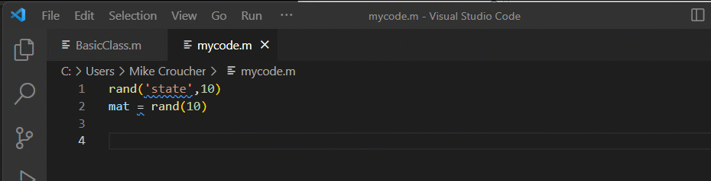
Use MATLAB in VS Code
Find MATLAB extension for VS Code on VS Marketplace
Without MATLAB installation
Basic editor features - syntax highlighting, code folding, etc.
With MATLAB installation
Advanced editor features - code analyzer, autocomplete, etc.
Code execution, Debugging
Get started:
https://www.youtube.com/watch?v=kYTBAr9LlGg
https://blogs.MathWorks.com/MATLAB/2023/04/26/do-you-use-visual-studio-code-MATLAB-is-now-there-too/
Notes:
As just one example of what that looks like, you can use MATLAB in VS Code through the MATLAB extension for VS Code on VS marketplace. Even without a MATLAB installation you'll get some basic editor features like code highlighting, but with a MATLAB installation you'll get advanced editor features such as code analyzer messages, code hints, and auto completion. And of course the ability to execute the MATLAB code and view the results.

Slide 24
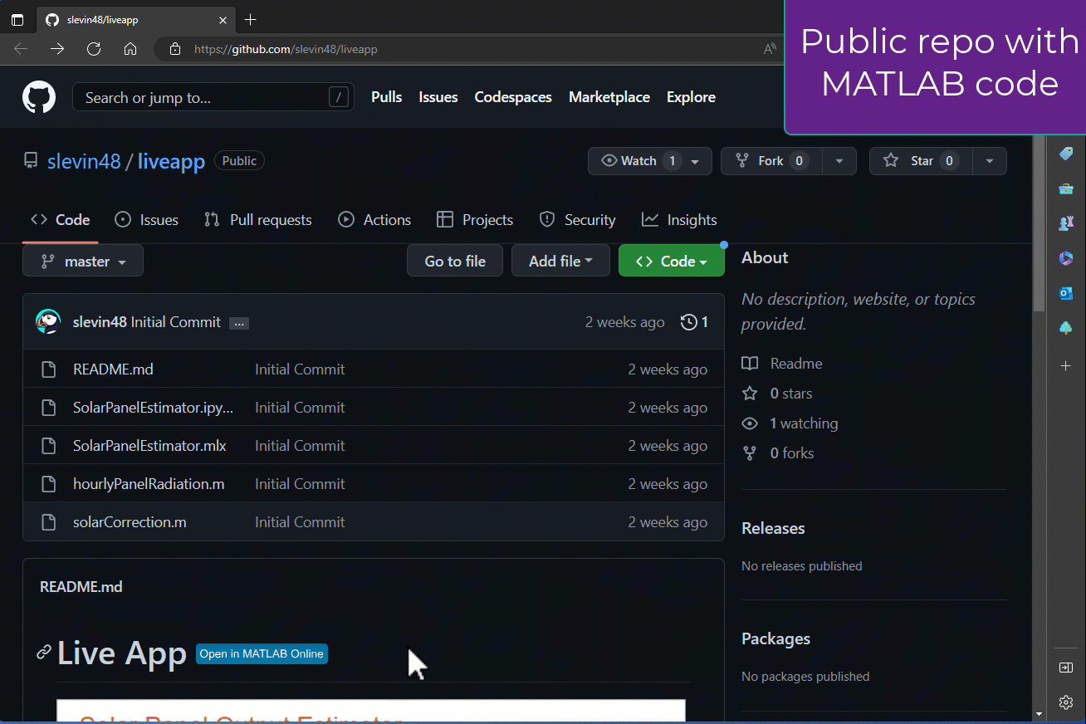
Directly open GitHub and File Exchange repos in MATLAB Online
Add button to any GitHub repo
Opens in MATLAB Online
Runs in-browser
MATLAB Online Basic for unlicensed users
Open in Focus Mode
Great for collaboration
Open science
Reproducible research
Community toolbox building
Notes:
When you share your work through either GitHub or the MATLAB File Exchange, users can open it directly in MATLAB Online with one button click. This version of MATLAB runs in your browser without a local installation, so others can not only see your code but also edit and run it, and in many cases this will work even for unlicensed users through something called MATLAB Online Basic. This workflow is especially great for open science, reproducible research, and community toolbox building.

Slide 25
Agenda
ARTIFICIAL INTELLIGENCE
WITH MATLAB
OPEN SOURCE INTEGRATION, SOURCE CONTROL
MATLAB MOBILE, MORE EXAMPLES

Slide 26



Model Deployment

Slide 27
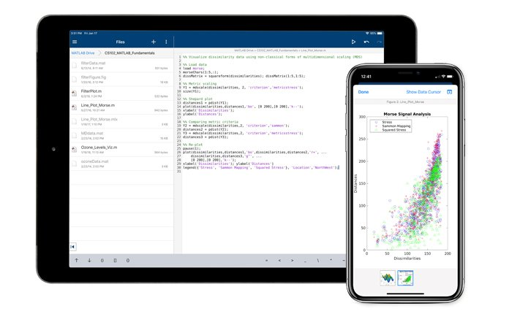
MATLAB MOBILE
Download MATLAB Mobile from your app store to use MATLAB on the go and connect directly to your mobile device’s sensors!

Slide 28
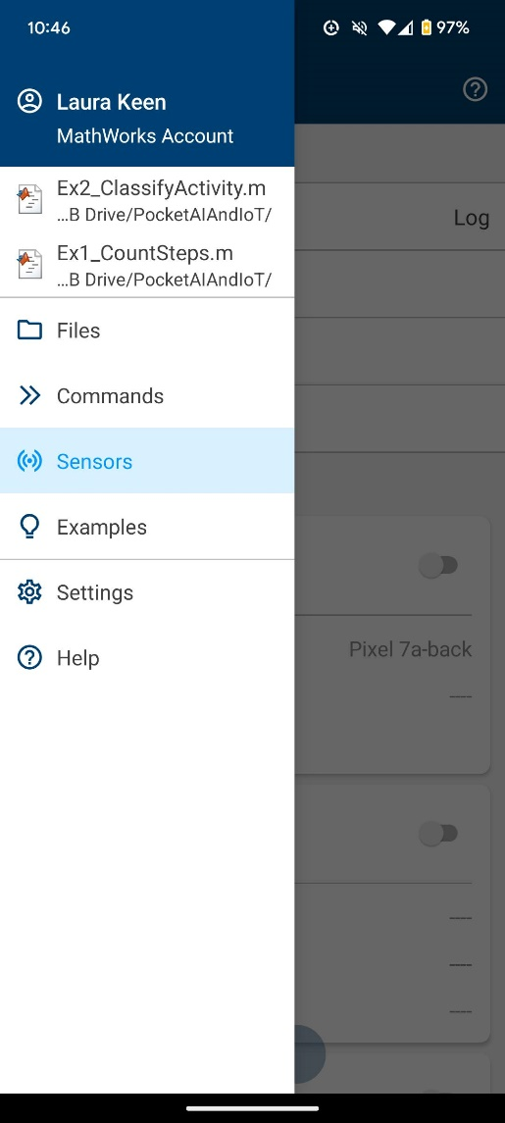
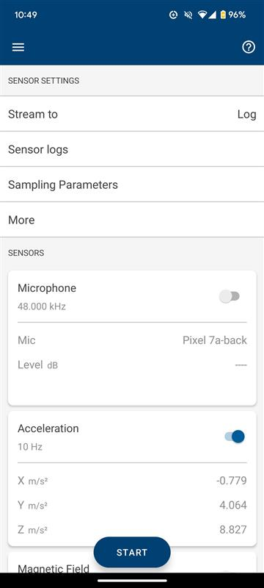
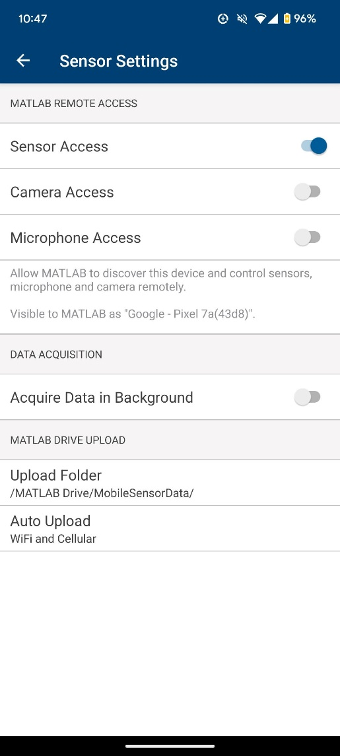
MATLAB MOBILE
To use sensors, enable permissions for MATLAB Mobile.

Slide 29
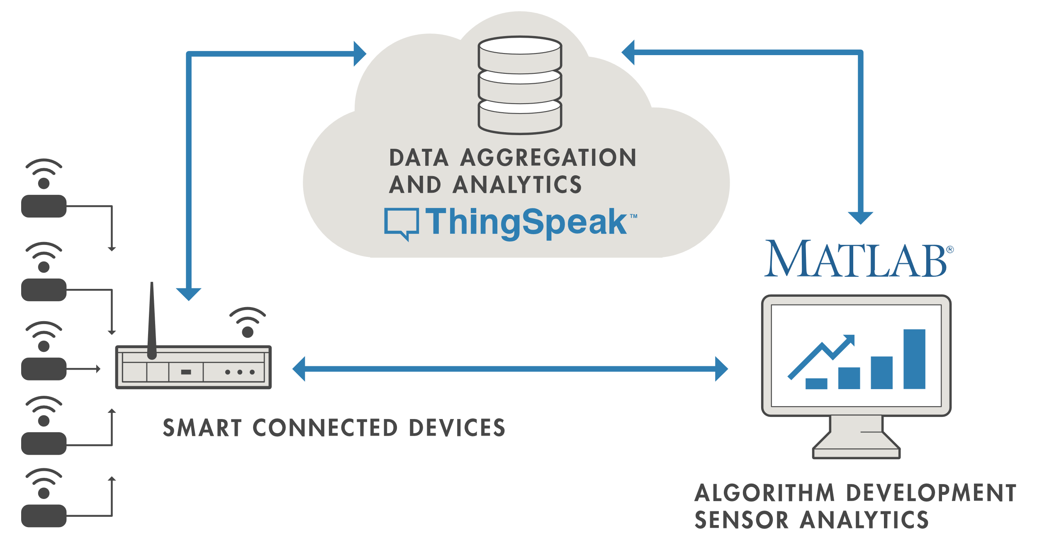
ThingSpeak and Internet of Things (IoT)
thingSpeakRead

Slide 30
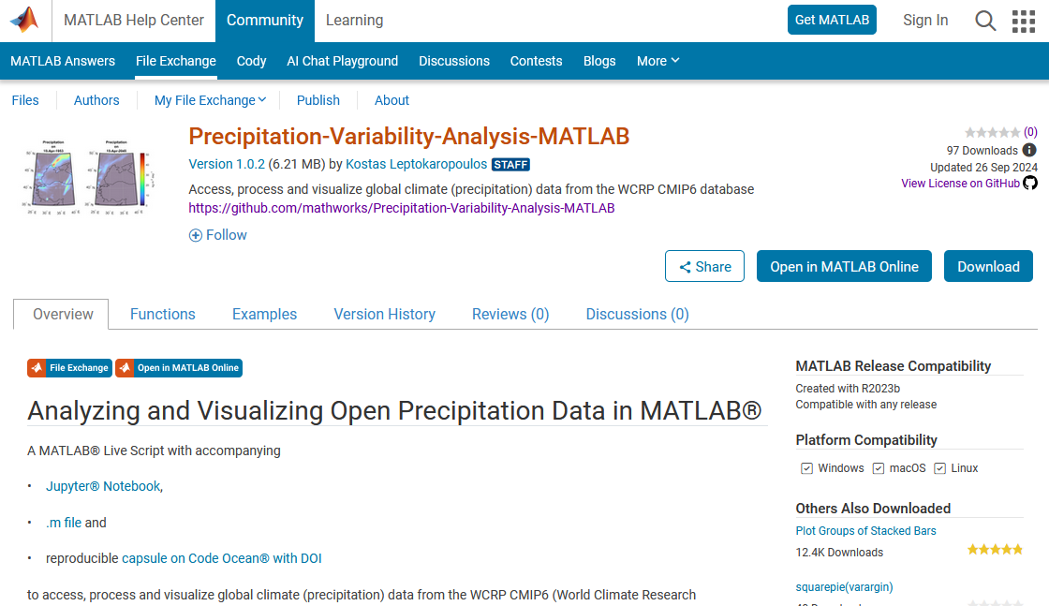
Analyze Open Precipitation

Slide 31
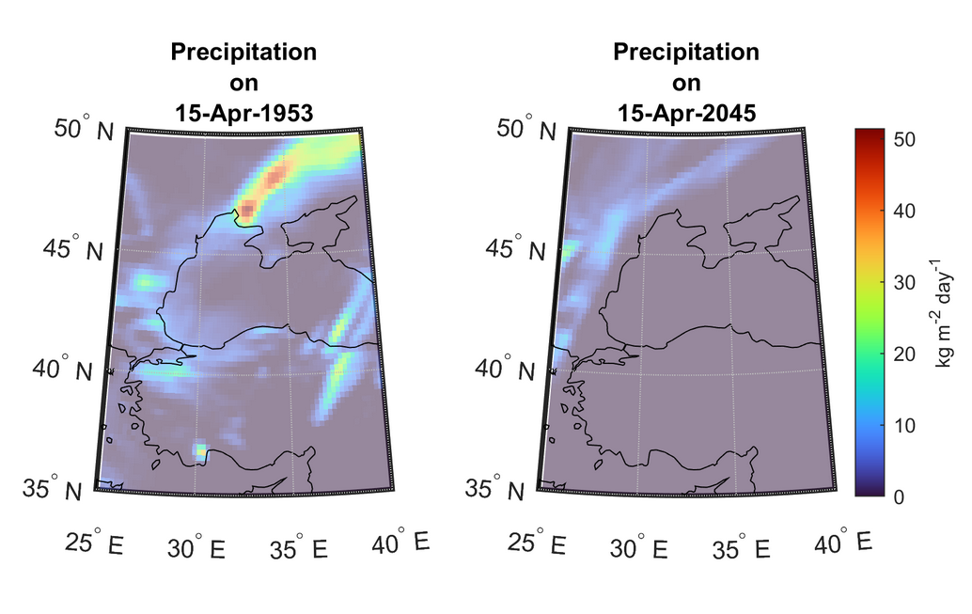
Analyze Open Gravitational Wave
https://www.mathworks.com/matlabcentral/fileexchange/160986-precipitation-variability-analysis-matlab?s_tid=srchtitle

Slide 32
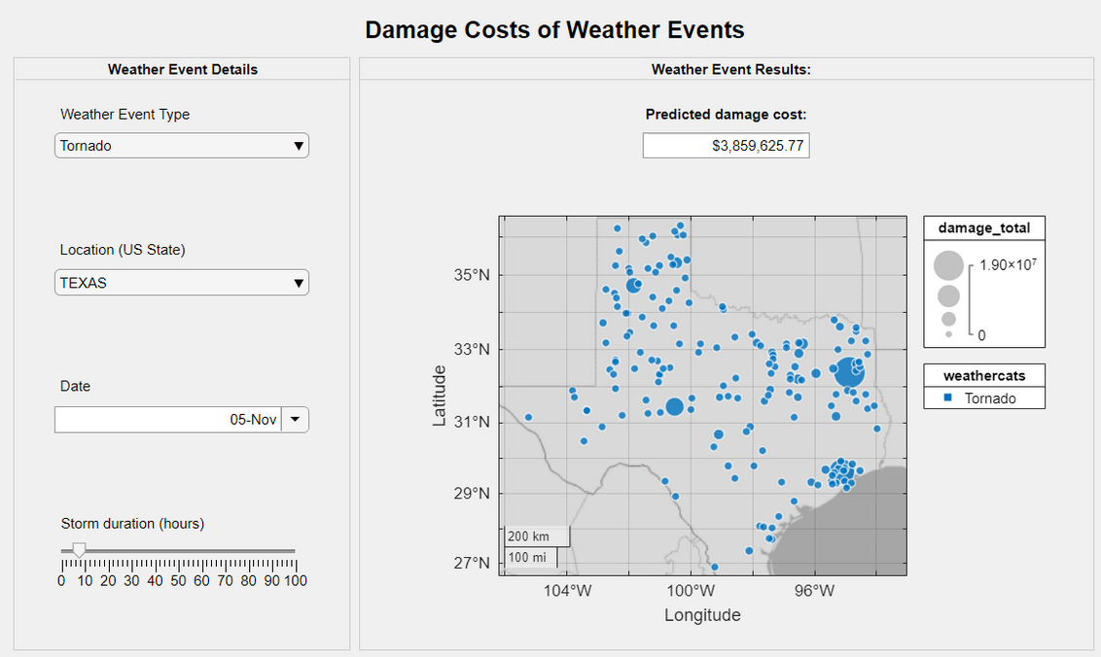
Forecast Damage Costs of Weather Events
https://www.mathworks.com/matlabcentral/fileexchange/69337-data-science-predict-damage-costs-of-weather-events?s_tid=ta_fx_results

Slide 33
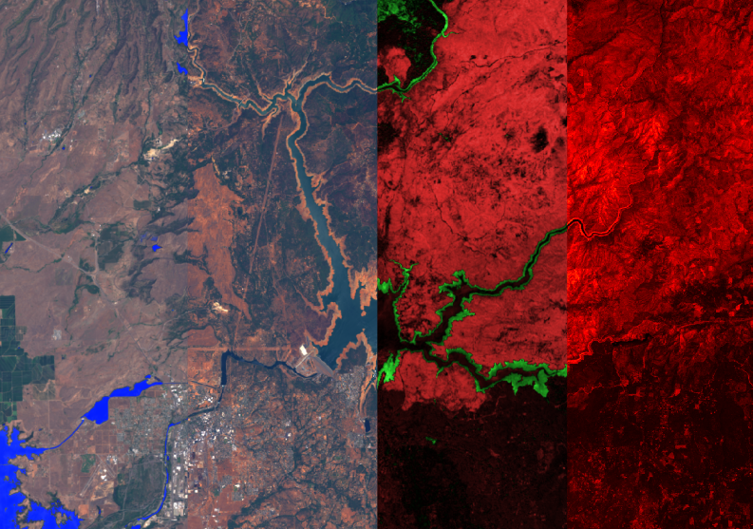
Multispectral Climate Data Analysis
https://www.mathworks.com/matlabcentral/fileexchange/110125-climate-data-visualization-and-analysis
Notes:
Explores IAU, HD, YBS, GCVS, and open-source star catalogs, BAA variable star data, IAU constellation boundaries, and asterism lines.

Slide 34

Join Here

Slide 35





Learn more
mathworks.com
Follow MathWorks at

